Slide 1

NIGERIAN AIRSPACE MANAGEMENT AGENCY
INTRODUCTION TO BASICS LINUX COURSE
By
Engr. Mohammed Sadiq Bandiya
(CCNA,CCNP,RHCSA,RHCE,AWS CCP, AWS SAA, OCI ASSOCIATE, OCI MULTICLOUD ASSOCIATE)
Whatsapp:+2348033911393
e-mail: msadeeq030@gmail.com

Slide 2
INTRODUCTION
Why should we learn about Linux?
It’s a fast growing operating system, and it’s inexpensive and flexible. Linux is also a major player in the small and mid-sized server field and it’s an increasingly viable platform for workstation and desktop use as well.

Slide 3
What is Linux?
Linux is a clone of the Unix operating system (OS) that has been in many business environments for years. Formerly used exclusively on large mainframes, Linux can now run on small computers, which are actually far more powerful than the mainframes of just a few years ago. Because of its mainframe heritage, Unix (and hence also Linux) scales well to perform today’s demanding scientific, engineering, and network server tasks.
Notes:
Linux is not UNIX:
UNIX was created by AT&T employees (is an American Multinational Telecommunications Corporation,Hqtr; Texas.) in 1969, Linux was written by a single man named Linus (Benedict) Torvalds around 1991.
Linux comes in many varieties, which are called distributions: Fedora,Redhat,Centos,Mint,Suse,Ubuntu,Debian etc. Even Android is a Linux distribution.

Slide 4
Linux consists of a kernel, which is the core control software, and many libraries and utilities that rely on the kernel to provide features with which users interact. The OS is available in many different distributions, which are collections of a specific kernel with specific support programs.
The Popular Linux distributions are; RedHat, CentOS, Fedora, Ubuntu, Open Suse, Debian, Xentoo, Mepis, Back track, Free bsd, etc
Notes:
what is Kernel? Kernel is the main core of any Linux Based distribution. All linux based distribution is created on the basis of Linux Kernel. Kernel is developed by Linus Benedict Torvalds in 1991. The first kernel version was 0.01 that was developed in 1991. In 1994 Linus Torvalds created kernel 1.0 . World first Linux based distribution is created by RED HAT company in 1994 on the base of Linux Kernel 1.0 .

Slide 5
Features of Linux
(1). Multi User (2). Multi-Tasking (3). Open System (4). Security (5). Programming Facility (6).Portability (7). Communication (8). Help Facility.
Multi User: More than one user can access same system resources i.e. (hardware, memory, printer, etc.) at the same time known as multi user.
Multi-Tasking: Execution of more than one task (or) application simultaneously known as multi-tasking. The main concept of multi-tasking is maximum utilizing CPU resources. eg: At a time we can run multiple tasks, i.e. editing task, compile task, printing, etc.
Open System: Linux had bright feature, i.e. open source code. Any user can modify Linux open source code, can develop its own O/S based on our business requirements.
Security: Linux given 2 levels of security; (a) System level security (b). File level security.
System level security: System level security controlled by System Administrator.
(b). File level security: File level security controlled by owner of the file.
5. Programming Facility: Linux O/S provides shell, shell works like a programming language. It provides commands and keywords;

Slide 6
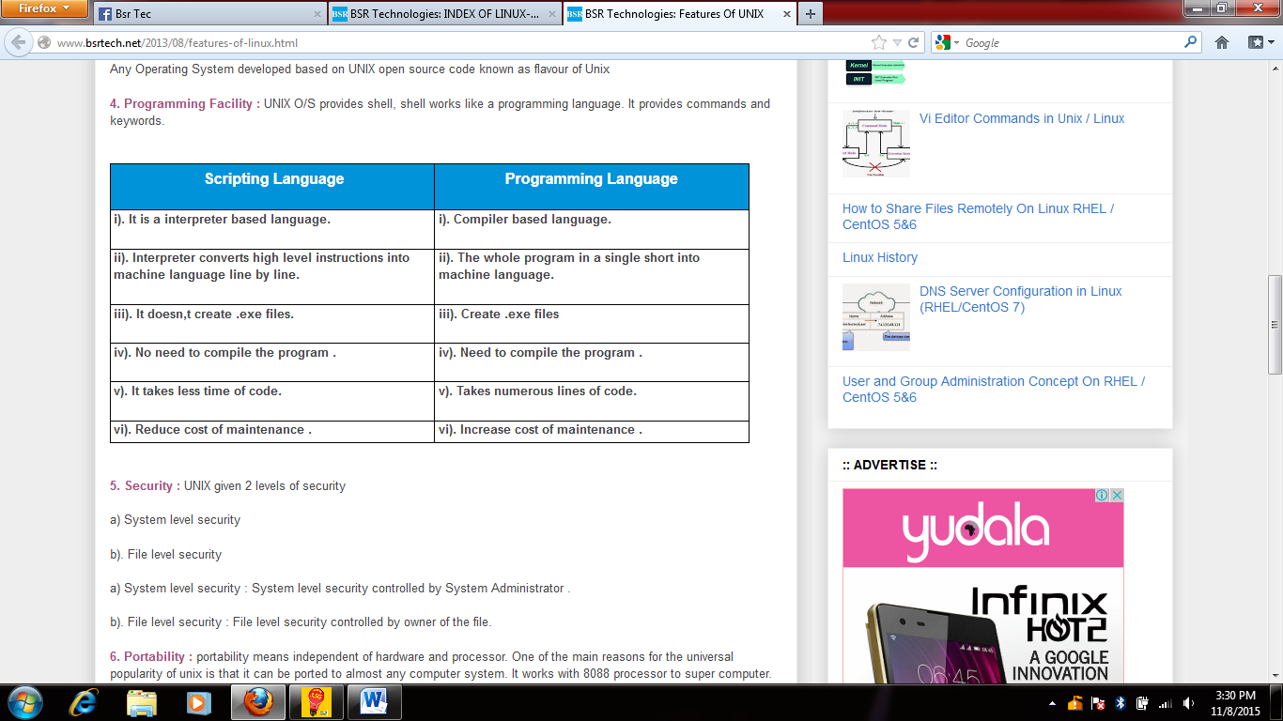

Slide 7
6. Portability: portability means independent of hardware and processor. One of the main reasons for the universal popularity of Linux is that it can be ported to almost any computer system. It works with 8088 processor to super computer.
7. Communication Facility: The main concept of communication facility is exchanging of information (or) files from one user account to another user account. The communication maybe within the network of a single main computer (or) between two or more such computer networks, the user can easily exchange mail, data, and programs through such networks.
8. Help Facility: Linux provides manual page for Linux commands. Man is the command to see the help.
E.g.: # man useradd
# man userdel
# man vim

Slide 8
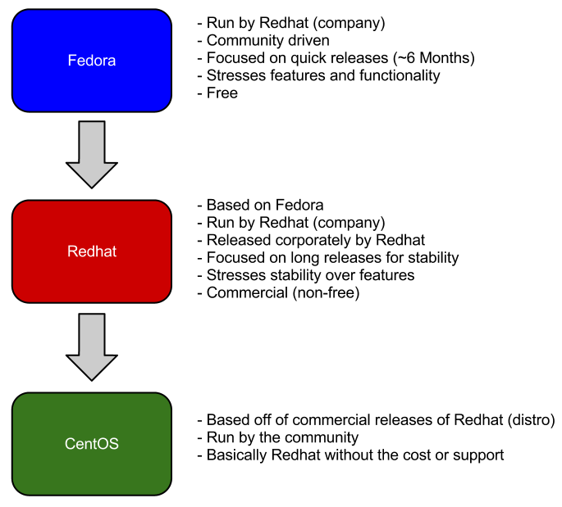
The Different between Fedora, Redhat and CentOS

Slide 9
The relationship between Fedora, Redhat and CentOS. Are they the same company? Is one another version of the other? Which one is more up to date? etc.
As shown in the graphic above, they go in order starting from above;
Fedora; is the main project, and it’s a community-based, free distro focused on quick releases of new features and functionality.
Redhat; is the corporate version based on the progress of that project, and it has slower releases, comes with support, and isn’t free.
CentOS; is basically the community version of Redhat. So it’s pretty much identical, but it is free and support comes from the community as opposed to Redhat itself.

Slide 10
Red Hat 6 Installation: Graphical installation through CD/DVD (it has the same procedure of installation with CentOS)
1. Select installation or upgrade an existing system option on Grub menu
2. Select Skip

Slide 11
3. Choose a language
4. Choose a keyboard type

Slide 12
5.Choose an installation media
6. Redhat 6 graphical installer starts, select Next

Slide 13
7. Select storage devices
- basic storage devices, next
8. Discard the data from the partition
no, keep any data, next

Slide 14
9. Insert computer name
10. Select time zone

Slide 15
11. Enter the password for root user
12. Select type of installation

Slide 16
Choose Create Custom Layout
13. Please Select A Device:
Free, Click Create
Create Storage: Standard Partition, Click Create
Add Partition:
* Mount Point = /
* File System Type = ext 4
* Size (MB) = 10000
* Additional Size Options = Fixed size, then ok
- Create Storage: Standard Partition, Click Create
- Add Partition:
* Mount Point = / boot
* File System Type = ext 4
* Size (MB) = 250
* Additional Size Options = Fixed size, then ok

Slide 17
- Create Storage: Standard Partition, Click Create
- Add Partition:
* Mount Point =
* File System Type = swap
* Size (MB) = 2000 for 1GB RAM System (Swap = 2xRAM Size)
* Additional Size Options = Fixed size, then ok
- Create Storage: Standard Partition, Click Create
- Add Partition:
* Mount Point = / home
* File System Type = ext 4
* Size (MB) = 100
* Additional Size Options = Fixed size, then ok
Note:-
You can also create /usr, /var, /tmp directory.

Slide 18
- Below is the snapshot of the above sample procedure for / (root) directory:
- Click Next ---- Format ------ Write changes to disk
Note:-
Write changes will create partitions to disk.

Slide 19
14. Configure boot loader options
15. Select softwares to install and enable repositories

Slide 20
16. Customize package selection, by clicking customize now, Next 17. Checking dependencies packages selected for installation
18. Starting installation process

Slide 21
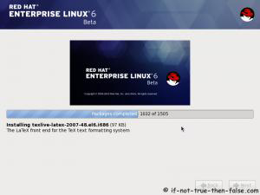
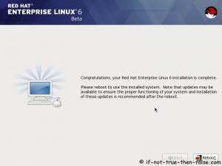
19. Installing packages
20. Installation is complete, Click Reboot and Remove the Installation Media.

Slide 22
21. Redhat 6 finished installation
Redhat 6 Welcome Screen

Slide 23
You can create a normal user, here
Set up date and time

Slide 24
Login redhat 6 gnome desktop
Red Hat 6 Gnome Desktop empty and default look
Done!!!

Slide 25
How to install VMware 8 on your System (Window Operating System):-
Double click on the VMware folder, you will find the setup and VMware 8 (text document)
Click on setup, to start the installation, and then click yes
Next, then typical --- Next ---- Next ----- Next
Continue, the installation and configuring additional component will start automatically
Enter License key; open VMware 8(text document) copy any of the license key and paste it, Enter.
Finish.

Slide 26
To install a RedHat 5 iso.image that will work on the VMware workstation 8:-
- On the Virtual Machine, click on Create a New Virtual Machine
- Click on typical, then next
- Click on installer disc image file (iso)
- Click on Browse, go to where you saved the (rh5 iso) and upload it.
NOTE: - on the filename, change it to All files (*.*) before the upload.
- Then Next
- Personalize Linux
• Full name:
• Username: is default user name to be display while using the VMware machine
• Password: Choose the password of the default user and root user as while. Then Next.
- Specify Disk Capacity:
• Maximum disk size (GB): 30.0 above (if possible)
• Click on Store Virtual disk as a single file
- Then, Next, Customize Hardware
- Choose NAT Adapter (NAT) on a left side of a dialogue box
- Choose, Bridge: Connected directly to the physical network, then close and Finish.

Slide 27
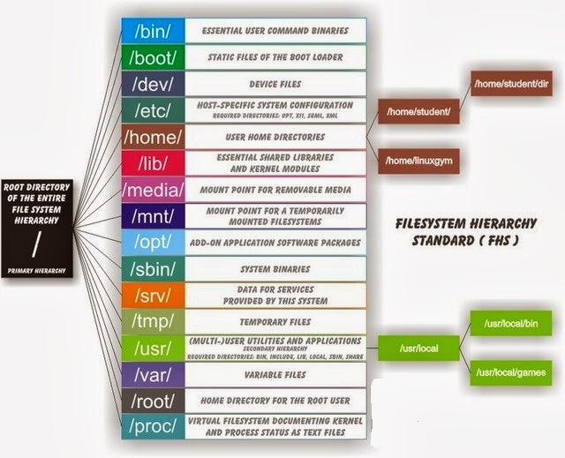
FILE SYSTEM HIERARCHY
File System is a mechanism used in the O/S environment for storing the data in a systematical order into a storage device. UNIX/LINUX follows hierarchy file system standard (HFS).
In this file system all other directories mounted under the directory called Root ( / ).
/ (Root) Top of the directory).
/root = Super User (or) Administrator home directory, it represented by “~ "(tilde) symbol.

Slide 28
“/” this directory is called as root directory, it is the top of filesystem structure. All other directories are mounted under it.
/root: this is default home directory of administrator
/home: It contains all users home directories.
/boot: It contains bootable files like kernel (initrd image),bootloader (GRUB), installer (ANACONDA-ks.cfg)
/sbin: It contains administrative commands used by super user (root) i.e. ADMINISTRATOR
/bin: It contains commands used by super user & normal user.
/usr: It contains the packages and application which are available for user (similar to program files on windows)

Slide 29
7. /var: It contains variable information such as logs and print queries.
8. /lib: It contains libraries need by no. of different application as well as Linux kernel.
9. /etc: It contains all configuration files.
10. /proc: This directory contains current running process information.
11. /tmp: This directory contains temporary files used by the system.
12. /opt: It contains the third party application E.g.: Core word effect, Sun star office
13. /media: Removable media is stored under this directory.

Slide 30
14. /dev: This directory contains devices modes through which the o/s can access hardware (on software device on the system) e.g.;
DEVICE IDE SATA Primary master /dev/hda /dev/sda Primary slave /dev/hdb /dev/sdb Secondary master /dev/hdc /dev/sdc Secondary slave /dev/hdd /dev/sdd

Slide 31
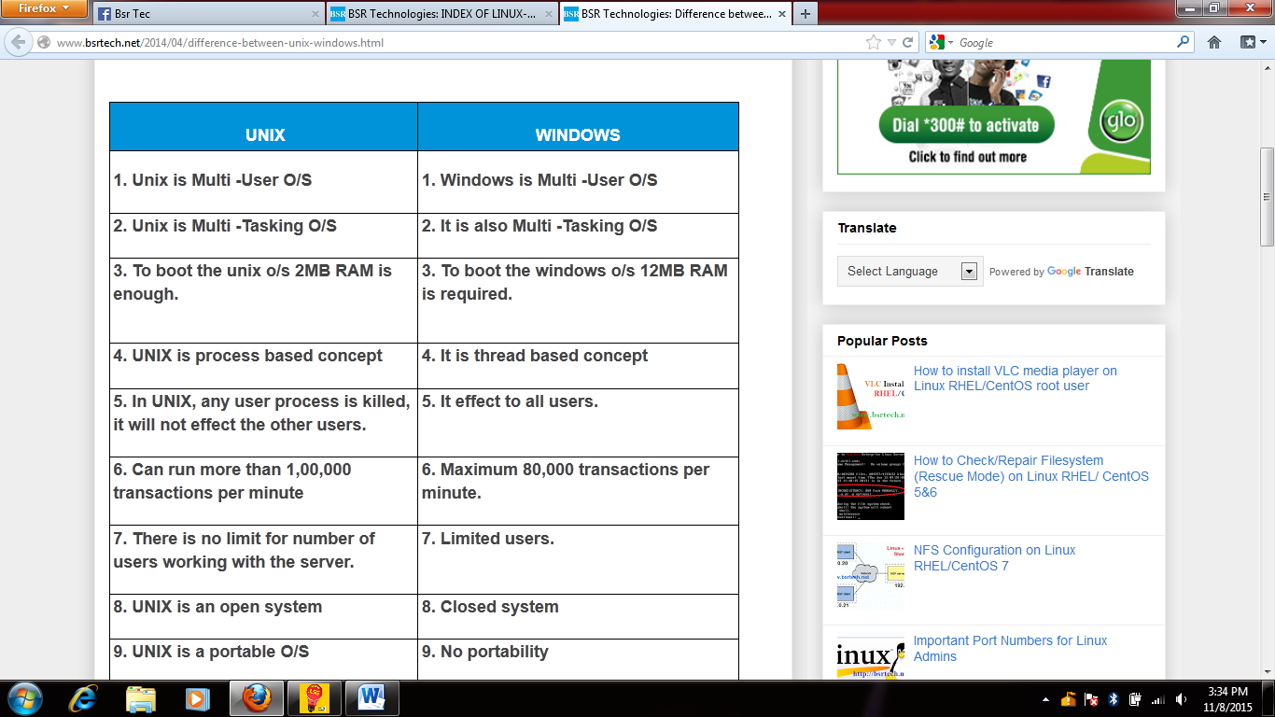
DIFFERENT BETWEEN LINUX/UNIX & WINDOWS:

Slide 32
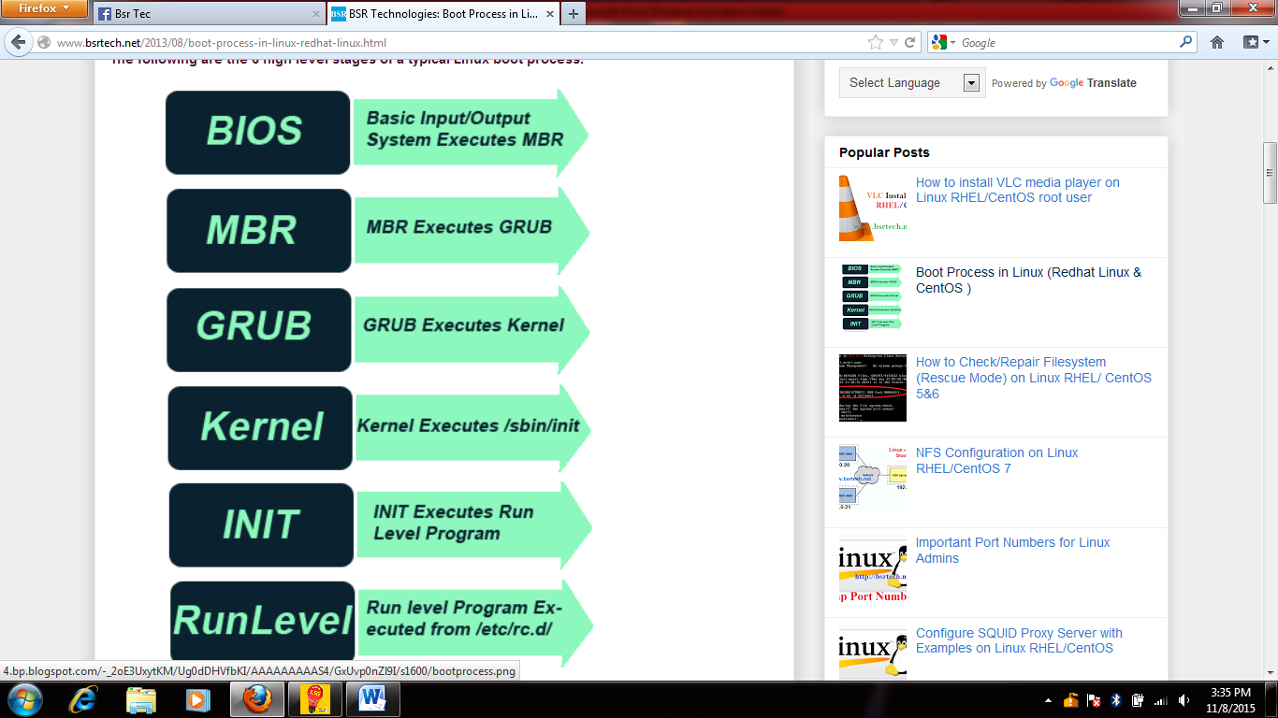
BOOT PROCESS IN LINUX (Redhat & CentOS)
Press the power button on your system, and after few moments you see the Linux login prompt.
Have you ever wondered what happens behind the scenes from the time you press the power button until the Linux login prompt appears?
The following are the 6 high level stages of a typical Linux boot process;

Slide 33
1. BIOS:
BIOS stands for Basic Input/Output System
Performs some system integrity checks
Searches, loads, and executes the boot loader program.
It looks for boot loader in floppy, cd-rom, or hard drive. You can press a key (typically F12,F2 or F11, it depends on your system) during the BIOS startup to change the boot sequence.
Once the boot loader program is detected and loaded into the memory, BIOS gives the control to it.
So, in simple terms BIOS loads and executes the MBR boot loader.

Slide 34
2. MBR:
MBR stands for Master Boot Record.
It is located in the 1st sector of the bootable disk. Typically /dev/hda, or /dev/sda.
MBR is less than 512 bytes in size.
It contains information about GRUB (or LILO in old systems).
So, in simple terms MBR loads and executes the GRUB boot loader.

Slide 35
3. GRUB:
GRUB stands for Grand Unified Bootloader.
If you have multiple kernel images installed on your system, you can choose which one to be executed.
GRUB displays a splash screen, waits for few seconds, if you don’t enter anything, it loads the default kernel image as specified in the grub configuration file.
GRUB has the knowledge of the filesystem (the older Linux loader LILO didn’t understand filesystem).
Grub configuration file is /boot/grub/grub.conf (/etc/grub.conf is a link to this). The following is sample grub.conf of CentOS.

Slide 36
#boot=/dev/sda default=0 timeout=5 splashimage=(hd0,0)/boot/grub/splash.xpm.gz hiddenmenu title CentOS (2.6.18-194.el5PAE) root (hd0,0) kernel /boot/vmlinuz-2.6.18-194.el5PAE ro root=LABEL=/ initrd /boot/initrd-2.6.18-194.el5PAE.img
As you notice from the above info, it contains kernel and initrd image
So, in simple terms GRUB just loads and executes Kernel and initrd images.

Slide 37
4. Kernel:
Once the control is given to kernel which is the central part of all your Linux OS and act as a mediator of hardware and software components. Kernel once loaded into to RAM it always resides on RAM until the machine is shutdown. Once the Kernel starts its operations the first thing it do is executing INIT process.

Slide 38
5. Init:
Looks at the /etc/inittab file to decide the Linux run level.
Following are the available run levels.
0 – halt (shutdown)
1 – Single user mode
2 – Multiuser, without NFS
3 – Full multiuser mode
4 – unused
5 – X11
6 – reboot
Init identifies the default init level from /etc/inittab and uses that to load all appropriate program.
Execute ‘grep initdefault /etc/inittab’ on your system to identify the default run level.
If you want to get into trouble, you can set the default run level to 0 or 6. Since you know what 0 and 6 means, probably you might not do that.
Typically you would set the default run level to either 3 or 5.

Slide 39
6. Run level programs:
When the Linux system is booting up, you might see various services getting started. For example, it might say “starting sendmail …. OK”. Those are the runlevel programs, executed from the run level directory as defined by your run level.
Depending on your default init level setting, the system will execute the programs from one of the following directories.
Run level 0 – /etc/rc.d/rc0.d/
Run level 1 – /etc/rc.d/rc1.d/
Run level 2 – /etc/rc.d/rc2.d/
Run level 3 – /etc/rc.d/rc3.d/
Run level 4 – /etc/rc.d/rc4.d/
Run level 5 – /etc/rc.d/rc5.d/
Run level 6 – /etc/rc.d/rc6.d/

Slide 40
Please note that there are also symbolic links available for these directory under /etc directory. So, /etc/rc0.d is linked to /etc/rc.d/rc0.d.
Under the /etc/rc.d/rc*.d/ directories, you would see programs that start with S and K.
Programs starts with S are used during startup. S for startup.
Programs starts with K are used during shutdown. K for kill.
There are numbers right next to S and K in the program names. Those are the sequence number in which the programs should be started or killed.
For example, S12syslog is to start the syslog deamon, which has the sequence number of 12. S80sendmail is to start the sendmail daemon, which has the sequence number of 80. So, syslog program will be started before sendmail.

Slide 41
LINUX BASIC COMMANDS
Command | Description
1. logname | Current user name
2. pwd | Present working directory
3. uname | Display kernel name
4. uname -n | Print network hostname
5. uname -r | Display kernel version
6. uname -v | Display kernel release date
7. uname -i | Print hardware platform
8. uname -o | Print the operating system
9. uname -p | Print the processor name
10. uname -a | Print all information
11. date | Display system date and time
12. clear | To clear the screen
13. cal | Display current month calendar
14. cal 2014 | Display 2014 calendar
15. cal 9 1987 | Displays the September 1987 calendar
16. bc | Open calculator
17. bc -v | Version of calculator
18. hostname | Display server name
19. hostname -i | Display server IP address
20. tty | Display terminal name
21. who | To display how many users connected to server
22. whoami | Display current username
23. uptime | Display how long server is “up &running”, no. Of users connected & avg load on the server.

Slide 42
24. which <command name> | Show the full path of command
25. whereis <command name> | Display the binary, source, and manual page files for a command
26. find / -name filename | To find any file or directory in Linux file system
27. who am i | Shows you the logged in terminal number and user name and more detailed information
28. diff | To display line by line differences between two text files
29. nl | To put line numbers on a file
30. wc | To display a count of lines, words and characters in a file
31. w | To show who is online
32. finger username | To display information about a user
33. cat /proc/cpuinfo | To display CPU information
34. cat /proc/meminfo | To display memory information
35. free | To show memory and swap usage

Slide 43
Set system date and time:
# date -s “yyyy-mm-dd hh:mm:ss”
To view help for a command (manual pages)
# man <command>
Viewing list of Files & Directories:
Syntax: # ls <options> <file>
Options:
-a = to check the hidden object
-l = to list the properties of an object
-s = to check the size in block
-r = to check reverse order
-R = list sub directories recursively
-Q = to see files in double quotes
-m = list of entries with comma separated
Example:-
# ls –a
# ls –la
# ls -lr

Slide 44
WORKING WITH FILES
A collection of data is called file. In Linux platform, cat, touch, vi are the default commands to create a file, but there are some differences between these three commands.
Cat (concatenation):
This command is used to create single file with data and also to check the data of exiting file, but we cannot modify the data.

Slide 45
Example; to create a file:
# cat > file
-------------
-------------
ctrl+d (save & quit)
Open the file:
# cat filename
To append the file (to add something into the file):
# cat >> filename
-------------------
--------------------
ctrl+d (save & quit)
To open multiple files:
# cat file1 file2 file3
Disadvantages: Using this command we can't create multiple files and we can't edit the text in the file.

Slide 46
Touch:
This command is used to create multiple files, but are empty files and also it use to change date and time of an existing files and directories.
Example; to create multiple files:
# touch file1 file2 file3
Disadvantages: Using this command we can't modify the text of the database files.
Change Time stamp of a file or directory:
Syntax:
# touch <option> <argument> <file/directory>
# touch –t YYYYMMDDHHMM <file/directory-name>

Slide 47
Vi:
This command is used to create single file with data, to check the data of exiting file and also to modify the data.
# vi file1
Deleting the files :
“rm” command is used for remove files;
Syntax:
# rm <filename> --> (by default, it will ask for confirmation, just like # rm –i)
# rm -i <filename> --> asking confirmation
# rm -f <filename> --> delete file forcibility.
Remove multiple files at once:
# rm <file 1> <file 2> <file 3>

Slide 48
WORKING WITH DIRECTORIES:
“mkdir” (Make Directory) command is used for creating Directories.
Syntax: # mkdir <option> <Directory name>
Example; # mkdir <dir name>
Creating multiple directories:
# mkdir dir1 dir2 dir3
Creating nested tree structure (sub directories inside directories):
# mkdir -p nigeria/nama/surveillance/cpdlc
To check nested directories:
# ls -R nigeria (or) # tree nigeria
Removing Directories:
“rmdir” (remove directory) command is used to delete an empty directory.

Slide 49
Syntax: # rmdir <dirname>
# rm -r <dirname> ---> command is used to delete recursively entire directory.
# rm -ri <dirname> --> asking confirmation message.
# rm -rf <dirname> --> remove forcefully (without asking yes or no)
To view the subdirectories and files under the directory
Syntax: #dir
Navigation Commands:
# cd = to change a directory.
# cd .. = to move one level back (previous directory).
# cd ../.. = to move two levels back.
# cd - = to go to the previous working directory (ie the directory you are working in before)
# cd <dir-name> = to move to the particular directory.
Copying files and directories:
“cp” command is used to copy file or directory from one place to another.
To copy a file;
# cp file1 file2

Slide 50
To copy a file into directory;
# cp file1 dir1
To copy multiple files into a directory;
# cp file1 file2 file3 dir1
To copy a directory;
# cp -R <source directory> <destination directory>
Example; # cp -R dir1 dir2
To copy entire directory along with subdirectories & files;
# cp -rf <source > <destination>
Example: # cp -rf sadeeq /home/nura
To copy a file or directory along with permissions
#cp -a <source> <destination>
Example: cp -a sadeeq /home/nura

Slide 51
Move and Rename – Files and Directories:
“mv” (move) command is used to move files and directories from one place to another, and also this command is used to rename the file and directories.
Syntax:
# mv <option> <source> <destination>
To move a file;
# mv file1 dir1
To move a directory;
# mv dir1 dir2
Renaming file and directory;
# mv <old name> <new name>
To create chain commands;
In Linux we can execute "n" number of commands at a single command line Syntax: command1;command2;command3; ex: date;cal2013;mkdir sadeeq; cd sadeeq;cd

Slide 52
Creating hidden files and directories:
To hide a file start file name with “.” character
# cat > .filename
# mv file1 .file1 (To hide existing file)
# mv .file1 file1 (To unhide a file)
# mkdir .dir1 (To create hidden directory)
# mv .dir1 dir1 (To unhide a directory)
Display long list format:
# ls -l (or ll ) (Display long list format, i.e, with 9 fields)

Slide 53
The Output above will display;
(i) File type, where '-' is a file and 'd' is a directory.
(ii) Permissions of file or directory.
(iii) Number of links (l) --> link file.
(iv) Owner of the file.
(v) Group of file.
(vi) File size in bytes.
(vii) Creation date of file.
(viii) Creation time of file.
(ix) Name of file.

Slide 54
Identify Files & Directories with colors:
# ls -l
The output will give the below colors;
Files = Green or Black (Green is executable file, while Black is non-executable file)
Directories = Blue
Links = Sky blue
Zip = Red

Slide 55
Vi Editor Commands in Unix / Linux
VI stands for visual interface, the mechanism of editor is use to modify the data of an existing file respect to the requirement.
In IT World, there are some default editors in various platforms.
Example: - Dos -- edit
Windows -- notepad
Linux -- CLI: vi,vim,nano and GUI: gedit,emacs,pico,nedit
Vim: This is one of the text base editor in Linux, which is not only use to create a new file, also we use to modify the data of existing file.
In vi editor; Three (3) modes are available: 1. Command Mode 2. Insert Mode 3. Execution Mode
“ vi ” is a command to open vi editor ,The default mode is command mode
Example;
[root@server1 ~ ]# vi <filename>

Slide 56
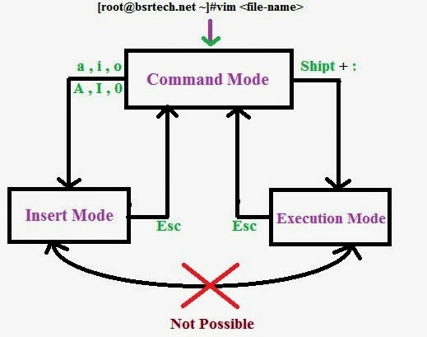
1. Command Mode:
This is a default mode of vi, which provide some following important operations, like copy-paste, cut-paste, and search the word name, etc...
2. Insert Mode:
The function of this mode to write new data into the file and also to modify the data in the file.
3. Extended Mode (Execution Mode):
This is a last mode vi, which is use to save the modification of files and also to quit from vi.

Slide 57
To shift from command mode to insert mode:
i = it place cursor at left side of the cursor line.
I = it place cursor at beginning of the current line.
a = it place cursor at right side of the cursor line.
A = it place cursor at end of the current line.
o = it inserts new line below of the cursor.
O = it inserts new line above of the cursor.

Slide 58
Command Mode Commands:
H = beginning of the current page
M = middle of the current page.
L = end of the current page.
$ = end of the current line (end key)
^ = beginning of the current line (home key)
x = delete current character (del key)
ctrl + f = forward one page (pg Dn key)
ctrl + b = backward one page (pg Up key)
dd (ndd) = delete the current line (delete n lines)
dw (ndw) = delete current word (delete n words)
yy (nyy) = copy the entire line (copy n lines)
yw (nyw) = to copy a word (copy n words)

Slide 59
y$ = it copies current position to end of the line
y^ = it copies current position to beginning of the line.
p = paste below the cursor
5p(np) = paste 5 times
P = paste above the cursor
u = undo
ctrl + r = redo
Shift+zz(ZZ) = save and quit
gg = move to the beginning of the line
G = move to the end of the line
77G = go to the 77th line
/<find word> = find the particular word
h = move to left
k = move to top
l = move to right
j = move to down

Slide 60
Execute Mode Options:
:w = save without quit
:w <filename> = save with given filename
:q = quit without saving changes
:q! = quit with forcefully
:wq = save and quit
:wq! = save and quit forcefully
:x = save and exit
:set number (se nu) = set line number
:set nonumber (se nonu) = to remove line numbers
:5d (nd) = delete 5th line
:$d = delete last line
:3,6 d = delete 3rd line to 6th line
:! <unix command> = execute unix command

Slide 61
:/string/ = top to bottom search
:?string? = bottom to top search
:6 (n) = place cursor at 6th line
:$ = place cursor at last line in the file
Replace String:-
:1, $ s/oldstirng/newstring/gi
:1, $ s/^/surveillance/ = It adds “surveillance” at beginning of each line
:1, $ s/$/; = It adds “;” at end of each line

Slide 62
Basic Linux Commands
The Commands which are basically use to operate Linux Operating System are called Basic Linux Commands;
pwd = present working directory ---> used to know the path of present user.
ls : list = it gives the list of files & Directories present in the path
ls -l or ll = listing of all files along with attributes
ls -a = lists all hidden files & directories
ls -r = lists all files & directories in reverse mode
ls –il = lists all files & directories along with inode numbers
ls -ld < directory name> = to view attributes of a particular directory
ls -R <directory.name> = to view tree structure of a directory
man <command> = to view entire options of a command

Slide 63
File Prompting Commands:
head: used to view first 10 lines of a file (by default) syntax : head <filename>
example: head /etc/passwd
To view 4 lines of a file:
Syntax:
# head -n <no of lines> <filename>
example: head -4 /etc/passwd
Tail : is used to view last ten lines of a file syntax: tail <filename> ex: tail /etc/passwd To view last 10 lines of a file: example: tail -10 /etc/passwd
More : used to see the content page wise but we cannot scroll up syntax: more < file name> example: more /etc/passwd

Slide 64
less: used to see the content page wise we can scroll up & down syntax: less <filename> example: less /etc/passwd
Date: used to view current date & time
To change date: date <mm-dd-hr-min-year>
example: date 120111452013 (it means 12th month, 01 day, 11 hours, 45 minutes, 2013 year)
cal : cal is used to view present months calendar
To view a particular month, particular years calendar
Syntax: cal <month> <year>
To view may 1986 calendar
example; cal 5 1986
To view entire 2050 year calendar.
example; cal 2050
| = this symbol is called “pipe” it is used to link commands.
example: ls | grep kano

Slide 65
User and Group Administration Concept on RHEL/CentOS 5&6
Let practice these commands:
vim /etc/passwd = contains user information.
vim /etc/shadow = contains users password information.
vim /etc/group = contains groups information.
cat /etc/passwd = to view total users info.
cat /etc/passwd | grep nama (or) getent passwd nama = to view only nama user information.
cat /etc/shadow = to view passwords of all existing users.
cat /etc/shadow | grep nama (or) getent shadow nama = to view only nama user password.
cat /etc/group = to view all groups information.
cat /etc/group | grep satcom (or) getent group satcom = to view only satcom group information.

Slide 66
To create a new user:
Syntax: #useradd username
To give a password to the user=sadeeq
Syntax:
#passwd sadeeq
Then the output will be; give a password for user sadeeq: (here you have to type a password for sadeeq user) confirm password:(again type the same password).
To remove a user
Syntax: #userdel sadeeq
You can also add a user with the options, ie:
useradd <option> <username>
-u : to change uid
Syntax:
useradd -u <uid no> <username>
ex: useradd -u 1000 sadeeq

Slide 67
-g : to add a user into a group(without primary group)
useradd -g <groupname> <username>
ex: useradd -g surveillance sadeeq
-G :to add an user into a group(with primary group)
useradd -G <groupname> < username>
-d : to change home directory of an user
Syntax:
useradd -d <home dir place> <username>
ex: useradd -d /usr/sadeeq sadeeeq

Slide 68
TO MODIFY AN EXISTING USERS ACCOUNT:
usermod : usermod is the command to change modifications to an existing user account.
usermod -u <username> : to change uid of an existing user.
To add an user into an existing group along with his primary group
usermod -G <groupname> <username>
To add an existing user into an existing group without his primary group
usermod -g <groupname> <username>
To change an existing users home directory.
usermod -d <home directory> <username>
To change shell for an existing user
usermod -s <shell> <username>
To add a user into a group
gpasswd -a
Syntax: gpasswd -a <username> <groupname>
ex: gpasswd -a saminu hr (here we are adding saminu into hr group)

Slide 69
To remove a user from a group
Syntax: gpasswd -d <username> <groupname>
ex: gpasswd -d saminu hr (here we are removing saminu from hr group).
To add n number of existing users into a group along with primary group.
Syntax: gpasswd -M <user1>,<user2>,<user3> <groupname>
ex: gpasswd -M bello, nura, abdul surveillance (here we are adding bello, nura, abdul into surveillance group)

Slide 70
To delete a user account
userdel -r
Syntax: userdel -r <username>
ex: userdel -r sadeeq (here we are deleting user sadeeq)
Group: group is nothing but logical grouping of users:
groupadd : this is the command to add a group
Syntax: groupadd <groupname>
ex: groupadd navaidsdepart
groupdel : groupdel is the command to remove a group.
Syntax: groupdel <groupname>
ex: groupdel navaidsdepart (here we are deleting navaidsdepart group).
groupmod : used to modify an existing group.
options:
-n : to change name of a group
Syntax: groupmod -n <newname> <oldname>
ex: groupmod -n electrocommsdepart itdepart

Slide 71
chgrp : chgrp is the command to change group ownership of a file or directory
Syntax: chgrp <groupname> <file or dir name>
ex: chgrp navaidsdepart /home/file1
chown : chown is the command to change ownership of a file or directory
Syntax: chown <username> <file or dir name>
ex: chown itdepatment /home/file2
chown -R :to change ownership & groupownership of a file or directory
Syntax: chown -R <owner:groupowner> <file or dir>
ex: chown -R sadeeq:itdepartment /home/file2 (here we are changing ownership of /home/file2 to sadeeq & groupownership to itdepartment group.

Slide 72
FILE SYSTEM PERMISSIONS IN LINUX
We can change permissions in two methods:
(1) symbolic mode
(2) absolute mode (numeric mode) 1) symbolic mode;
users permissions operators u=owner(user) r=read + g=group w=write - o=other x=execute =
chmod is the command to change permissions
Syntax: chmod <permissions> <file or dir name>
ex: chmod u=rwx, g=rx, o=rx file2
(here we are giving full permissions to owner, read & execute for group & others)
e.g, Below, we want to give write to group:
chmod g+w file2

Slide 73
2) Absolute mode:
In Absolute mode we have to provide permissions in numeric signs
r = 4 w = 2 x = 1
Syntax : <permissions of owner, group, other> <filename>
ex: chmod 755 file1 (here we are giving a full permissions to owner & read, execute to group & others)
If we want remove total permissions for others;
chmod 750 file1

Slide 74
HARD LINK AND SOFT LINK
HARD LINK | SOFT LINK
1. Can create only with in a partition | 1. Can create accross the partitions.
2. Inode number will be same. | 2. Inodes numbers are different.
3. Original & link file are in same size. | 3. Link file size is less than org.file.
4. If original file removed then also we can access link file. | 4. Link file can't be accessed if original file is removed.

Slide 75
To configure a hard link
Syntax: ln <source file><destination file>
ex: ln /dev/sda /dev/sdb
To configure a soft link;
Syntax: ln -s <source file><destination file>
ex: ln -s /usr/king /root/redhat

Slide 76
ACL (Access Control Lists):
To configure different set of file permissions for different users on a single resource (files/folder), Acls are implemented. Acls can be applied on users and groups.
To apply an Acl for an user
Syntax: setfacl -m u:<username>:<permissions> <file or directory name>
ex : setfacl -m u:sadeeq:rwx /file1
To check acls of file or directory
Syntax: getfacl <file or directory name>
ex : getfacl /file1
To apply an acl for a group
Syntax : setfacl -m g:<groupname>:<permissions> <file or directory name>
ex : setfacl -m g:surveillance:rwx /file1
To remove acl
Syntax :setfacl -x u:<username>: <file or directory name>
ex : setfacl -x u:sadeeq: /file1
ex : setfacl -x g:surveillance: /file1

Slide 77
Disk Management Concept on Linux (Redhat or CentOS 6)
To view all existing Disk Partitions using #fdisk -l
Note: before you create a new partition, or modify an existing partition, you might want to view all available partition in the system.
Use fdisk -l to view all available partitions as shown below. Device info will present under /dev:
ide = /dev/hda
sata = /dev/sda

Slide 78
For Creating a Partition;
[root@serv-1 ~]# fdisk /dev/sda
Options:-
m – To get the help
p - To print the partition table
n - To create a Partition
d – To delete a Partition
w - To save the modification
q - To quit without save.
n : for new partition
Note; if we want to create a new primary partition in an already existing one, the primary partition will be deleted. So, is better to go for logical partitions.
l : logical
Note; (we can't able to specify space in inodes)
Press enter; (provide size of partition)
+200M (here our partition size is 200 mb)
w: to save partition and write to partition table

Slide 79
partx: is the command to update kernel without reboot;
# partx -a /dev/sda
To format a partition (Let says Linux filesystem is ext4);
#mkfs.ext4 /dev/<partition no>
example: mkfs.ext4 /dev/sda5
df -Th : is the command to view mounted partitions along with mount points & free space
Mounting: Mounting is a process to create a logical way to enter a partition.
#mkdir /centos (mount point for drive)
mount: is the command use to view mounted partitions & to create mounting.
Syntax: mount <partition> <mount point>
example: mount /dev/sda5 /centos
umount: is the command to clear(remove) mounting way.
Syntax: umount < mountpoint>
example: umount /centos

Slide 80
To mount a partition permanently, we have to edit configuration file; /etc/fstab
# vi /etc/fstab
add a line at the end;
<partition> <mountpoint> <filesystem> <permissions> <fsck>
fsck: filesystem consistency check:
(a) if fsck is 1 1 only root can access
(b) if fsck is 1 2 anybody can access
(c) if fsck is 0 0 only system can access
For example:
/dev/sda5 /centos ext4 defaults 1 2
| | | | |
| | | | |
partition mountpoint file system permissions fsck

Slide 81
Backup & Recovery Concept on RHEL/CentOS 5.X&6.X
BACKUP:
Data Backup is the physical copying of data files to a removable storage device that allows the data to be stored in another location. When needed, an individual data file or an entire set of data files, can be restored to a computer system.
USES OF BACKUP & RECOVERY:
To copy data to alternate media.
To prevent data loss.
Note: Only administrators can back up the data.

Slide 82
TYPES OF DATA:
System generated data
User generated data
TYPES OF BACKUP:
(a) Full backup (b) Incremental backup (c) Differential backup
Full backup: complete backup of entire system.
Incremental backup: It includes all files that were changed since last backup. It always smaller than differential backup.
Differential backup: It includes all the files that were changed since last full backup. As time increases since the last full backup the size of differential backup increases.

Slide 83
Commands for backup:
tar (tape archive)
cpio (copy input/output)
Dump
tar:
# tar <options> <destination> <source>
Note: destination must be in .tar extension
Options: -c= create, -v= verbose, f= file, -t= table of content
-x= extract to, -w= interactive, -z= zip
To take backup:
#tar -cvf <path> <file name> <source>
ex: tar -cvf passwd.tar /etc/passwd

Slide 84
To list the content of tar file:
#tar -tvf <path> <file name>
ex: tar -tvf passwd.tar
To extract content of file:
#tar -xvf <path> <file name>
ex: tar -xvf passwd.tar
To take backup along with zip:
#tar -cvzf <path> <file name>
Note: file name must be with an extension of .tar.gz
example : #tar -cvzf passwd.tar.gz /etc/passwd

Slide 85
To extract zip file
#tar -xvzf <path> <file name>
example : #tar -xvzf passwd.tar.gz
b) cpio(copy input/output):
Backup using cpio:
#ls <options> | cpio -ov > <file name>
example:ls -l | cpio -ov > file1
To extract:
#cpio -iv <file name>
example:cpio -iv sun
c) dump:
Backup using dump:
#dump -Ouf <device> <file name>
example: dump -Ouf /media/<flashdrive> file1

Slide 86
To extract:
#restore -f <path>
example: restore –f file1
Remote backup:
#rsync -avz <source> -e ssh <destination IP>:<directory>
example: rsync -avz sadeeq -e ssh 192.168.1.20:/root/sadeeq
#scp -r <source> <destination IP>:<directory>
example: scp -r sadeeq 192.168.1.20:/root/sadeeq

Slide 87

RPM: redhat Package Manager on Linux RHEL/CentOS 6
RPM is the Redhat Package Management system. By using rpm utility the user can install new packages or upgrade, and can also remove existing packages.
Pattern: vsftpd-2.0.6-0.el6.i386.rpm
Above: very secure ftp daemon (vsftpd) is the name of package & 2.0.6-0.el6 is the version of package & i386 is the type of architecture of the package & .rpm is the extension.

Slide 88
To install rpm:
#rpm <options> <package> --force –aid options:
-i = install
-v = verbose
-h = to display progress in hashes
--force = to install forcefully
--aid = to install packages with dependencies
ex: rpm -ivh nfs-utils --force --aid
rpm -ivh nfs-utils-lib --force --aid

Slide 89
To upgrade:
#rpm <options> <packages>
options:
-U = upgrade
-v = verbose
-h = to display in hashes
ex: rpm -Uvh nfs-utils
rpm -Uvh nfs-utils-lib
To remove an rpm:
#rpm <options> <package> --nodeps
options: -e = to remove package from the system
--nodeps = remove without dependencies
ex: # rpm -e nfs-utils --nodeps

Slide 90
To query rpm package:
# rpm <options> <package>
options:
-q = to query the availability of installed package
-qa = queries all installed rpm's in o/s
-qc = list only configuration files stored in queried rpm
-qd = list only doc files stored in queried rpm
-qi = displays complete information about queried rpm
-qs = displays status of files in queried rpm
-ql = displays files related to queried rpm
-qf = query find of the package
ex :- To display information of Package
# rpm -qi nfs-utils

Slide 91
Note:
1. RPM database is maintained under - /usr/lib/rpm directory
2. All your installed rpm's log is under - /root/install.log
3. To install Packages in GUI Mode, enter this command
# system-config-packages &
To get rpm's from Server:
#mount 192.168.0.254:/var/ftp/pub /mnt (Mount point from 254 server to local system)
#cd /mnt
#cd Server (in mnt directory Server folder is there.)
#rpm -ivh <package> --force –aid
To get rpm's from CD/DVD:
place rhel-5 or 6 dvd in cd-rom
#mount /dev/cdrom /mnt
#cd /mnt
#cd Server
#rpm -ivh <package> --force --aid

Slide 92
Basic Network Concepts on Linux RHEL/CentOS 5&6
Below, is just to provide some idea about network and network commands
To check IP address and IP information:
#ifconfig
To set IP address:
#setup
Network configuration
Select Ethernet
Give IP address, subnet mask, gateway
Close
Quit
Quit, then #service network restart
To check Network connectivity:
Ping: packet internet gropher
#ping server IP

Slide 93
To check LAN card status:
#ping 127.0.0.1
To check host name:
#hostname
To change host name:
#hostname sadeeq
To view current version of kernel:
#uname -r
To view current run level:
#runlevel
To know the network statistics i.e (which port number of the server is connected to which port number of client):
#netstat -ant
This command is used to down the device:
ifdown <eth0>
This command is used to bring the interface up device:
ifup <eth0>

Slide 94
Important Port Numbers for Linux Administration:
A port number is part of the addressing information used to identify the senders and receivers of messages. Port numbers are most commonly used with TCP/IP connections.
Port numbers range is 0 to 65535, means total port numbers are 65536, the port number field is 16-bit size. So we get only 2^16(2 to the power of 16) ports , its equal to 65536 ports.
Default ports are 0 to 1023 (2^10=1024 ports), default ports means particular well known services such as ftp server, web server, mail server, dns server, samba server nfs server etc.., these servers are using default port numbers(dns=53, ftp=21, Apache=80, samba=139)
Note: You can see all Port Numbers in Linux /etc/services file
# vim /etc/services

Slide 95
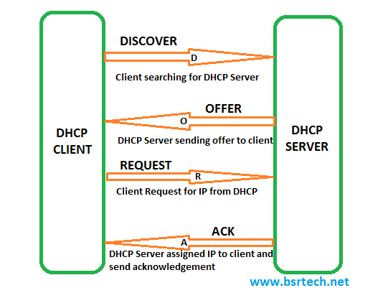
DHCP Server on Linux RHEL/CentOS
DHCP stands for Dynamic Host Configuration Protocol, One of the basic element found on all networks is a DHCP Server, making it an important part of any network.
DHCP makes Network Administration easy because you can make changes to a single point on your network and let those changes filter down to the rest of the network.
DHCP follows the “DORA “process; DORA means; D = Discover, O = Offer, R = Request, A = ACK

Slide 96
DHCP:
It gives IP Address automatically to the clients who is requesting for an IP Address. It provides centralized IP Address management. DHCP reduces the complexity and amount of administrative work by assigning TCP/IP configuration.
Note; Assigning IP Address dynamically has some problem that every time a client system boot it is not sure that it will get the same IP, So it will be tedious task for other systems to find the particular system.

Slide 97
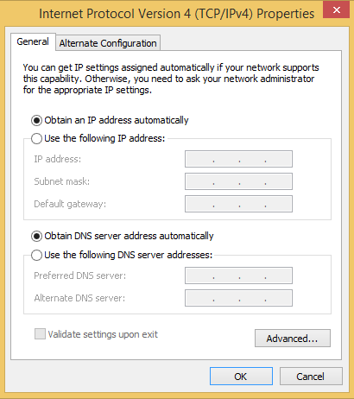
To configure windows system as DHCP clients open LAN card properties and select TCP/IP and click on properties and select obtain an IP Address automatically:
You can go on command prompt and check new IP address.

Slide 98
Some Troubleshooting Tips on your System
How to check ram and swap size in Linux or centos 6: In Command mode type below commands:
Ram size = # cat /proc/meminfo
Swap size = #free -m or free –g

Slide 99
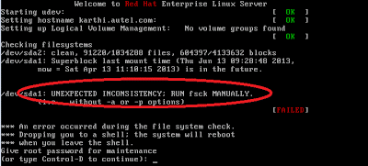
File system error after crash or power outage
At some point your system will crash and you need to perform a manual repair of your file system. A typical situation would be power loss while you are working on the system. You reboot and the system stops and indicates you must perform a manual repair of the system using fsck.
fsck (file system consistency check) is a command used to check file system for consistency errors and repair them on Linux file systems. This tool is important for maintaining data integrity so should be run regularly, especially after an unforeseen reboot (crash, power-outage).

Slide 100
Usage: fsck [-sACVRTNP] [-t fs-optlist] [filesystem] [fs-specific-options]
Filesystem can be either a device's name (e.g. /dev/hda) or its mount point. fsck run with no options will check all devices in /etc/fstab. It might be necessary to run fsck from single-user mode
Note: You need to be "root" to use any of the below mentioned command
Take system down to runlevel one: # init 1
Unmount filesystem, for example; if it is /home(/dev/sda2) file system then type command:
# umount /home OR # umount /dev/sda2
Now run fsck on the partition:
# fsck /dev/sda2
Specify the file system type using -t option:
# fsck -t ext3 /dev/sda2 (OR) # fsck.ext3 /dev/sda2

Slide 101
fsck will check the file system and ask which problems should be fixed or corrected. If you don't want to type “y” every time then you can use “-y” option to fsck:
# fsck -y /dev/sda2
Note; Please not if any files are recovered then they are placed in /home/lost+found directory by fsck command.
Once fsck finished, remount the file system:
# mount /home OR # mount /dev/sda2
Note; Make sure you replace /dev/sda2 with your actual device name.

Slide 102
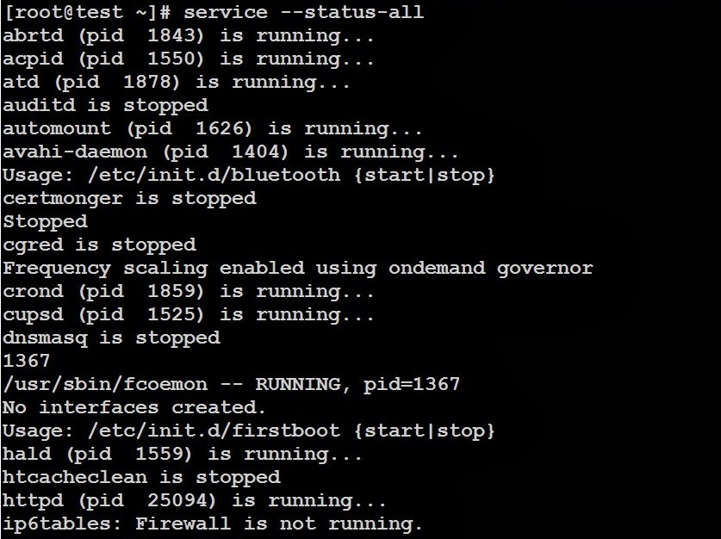
Check Running Services in Linux RHEL/CentOS
Many ways to check the services in Linux machines (Redhat/CentOS/Fedora), in this manual we will discuss how to see all running services and also stopped the services like “services.msc” file in WINDOWS.
To see the all services:
# service --status-all
# service --status-all | less

Slide 103
To search for a particular service “vsftpd”
# service --status-all | grep vsftpd
To see status of particular service
# service httpd status
To start the service
# service httpd start
To stop the service
# service httpd stop
To restart the service
# service httpd restart

Slide 104
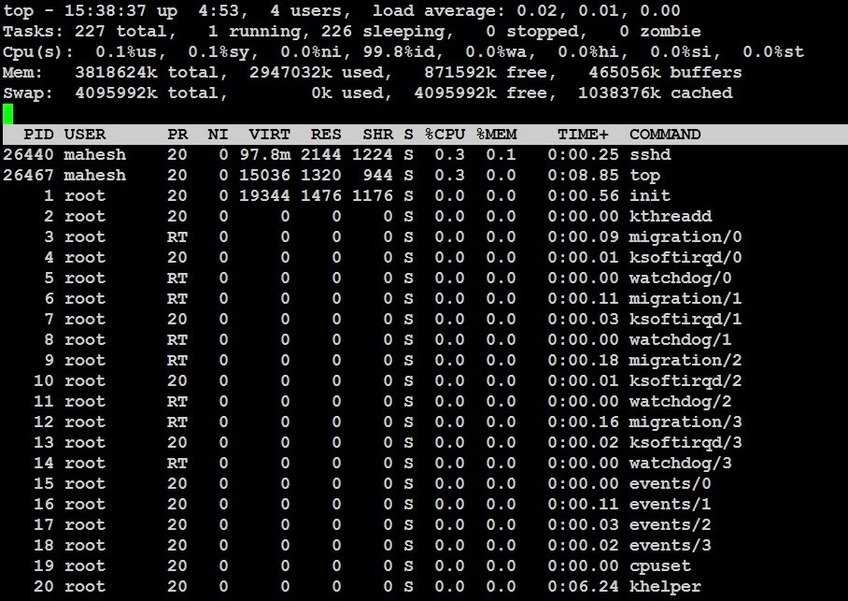
To see the top running services using top command
# top

Slide 105
You can see specific user top services:
# top -u <username>
To see all known service (status with runlevels):
# chkconfig –list
Note; chkconfig command is used to setup, view, or change services that are configured to start automatically during the system startup.
Turn off/on service:
# chkconfig service off
# chkconfig service on
To turn off/on a particular service:
# chkconfig smb off
# chkconfig httpd on

Slide 106
LINUX SCRIPTS

Slide 107
#!/bin/bash = Linux Shell
Consists of a Linux system of several components, the most important of these components is the Linux kernel and is the heart of the system, there are so-called chance (Shell) which is surrounded Linux kernel which is often called the coincidence Bash in all Linux distributions, almost coincidence Bash is responsible for the implementation of the orders of the terminal, for example, a responsible for taking orders and passed to the kernel and deal with it, which is very useful and depend on them most of the Linux applications.

Slide 108
For example, when you perform the ls command, which lists all the files and folders on the current track in the terminal, the chance Bash automatically track the implementation of the program in the /bin/ls, then the program is executed and is listed components of the current track. Script is a set of serial commands that are written for a particular job, you can perform anything and anything you want to modify on the system via shell scripts, Bash has the chance to read the orders and instructions of the shell script file and are being implemented to perform the task it was designed for. Script requirement orders be just like normal ls and pwd.

Slide 109
Below is a very simple example for Shell Script file, does ask you for your name, your organization and your department. Take these commands in a file and save it in a folder, Example 1 “tesh.sh”
#!/bin/bash
echo "Enter your name:";read name
echo "Enter your organisation:";read organisation
echo "Enter your department:";read department
echo "Hello $name",
echo "You are working at $organisation",
echo "You are in $department!"
echo "Good Luck!!!“
Then applied the following command to give the powers of the implementation of the file; chmod 755 test.sh Now to execute shell scripts;
./test.sh

Slide 110
Below is a very simple example for Shell Script file, does ask for your choice to give the output of ls –l, pwd, who, etc .Take these commands in a file and save it in a folder, Example 2 “choice”
# with if
echo " enter your choice “
read choice
if [ $choice = 1 ]
then
ls -l
elif [ $choice = 2 ]
then
pwd
elif [ $choice = 3 ]
then
who
Notes:
In Bash, we have the following conditional statements:
if..then..fi statement (Simple If)
if..then..else..fi statement (If-Else)
if..elif..else..fi statement (Else If ladder)
if..then..else..if..then..fi..fi..(Nested if)

Slide 111
elif [ $choice = 4 ]
then
hostname
elif [ $choice = 5 ]
then
uname -a
elif [ $choice = 6 ]
then
cal
elif [ $choice = 7 ]
then
bc

Slide 112
elif [ $choice = 8 ]
then
ls -a
elif [ $choice = 9 ]
then
logname
elif [ $choice = 10 ]
then
clear
fi
Then applied the following command to give the powers of the implementation of the file; chmod 777 choice Now to execute shell scripts;
./choice

Slide 113
ANY QUESTION?
THANKS FOR WATCHING

